Slide 1
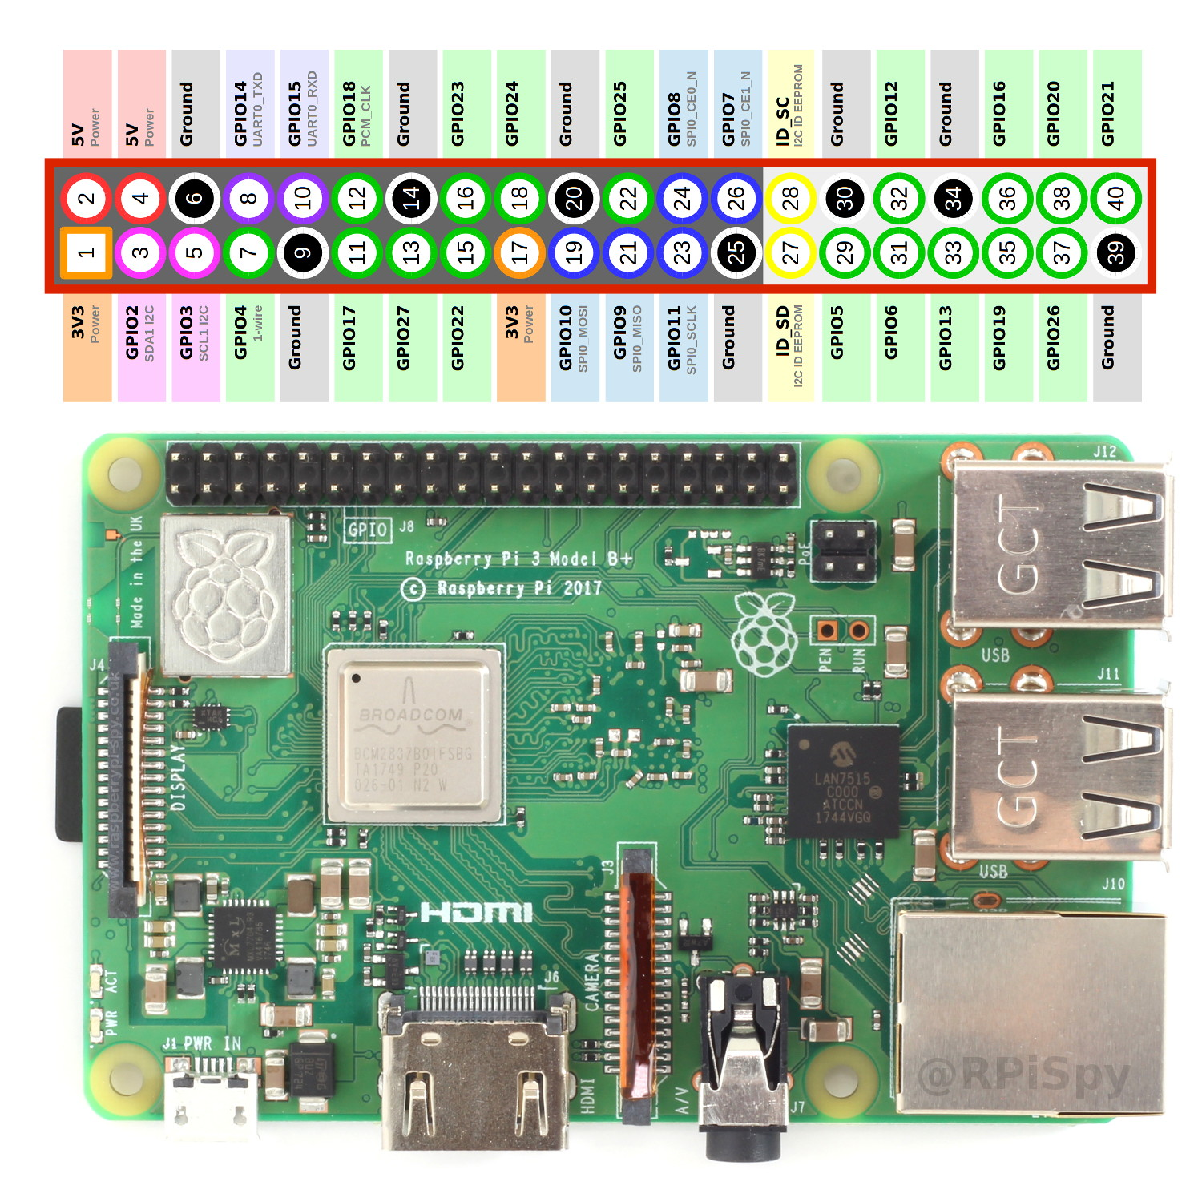
RPI Hardware

Slide 2
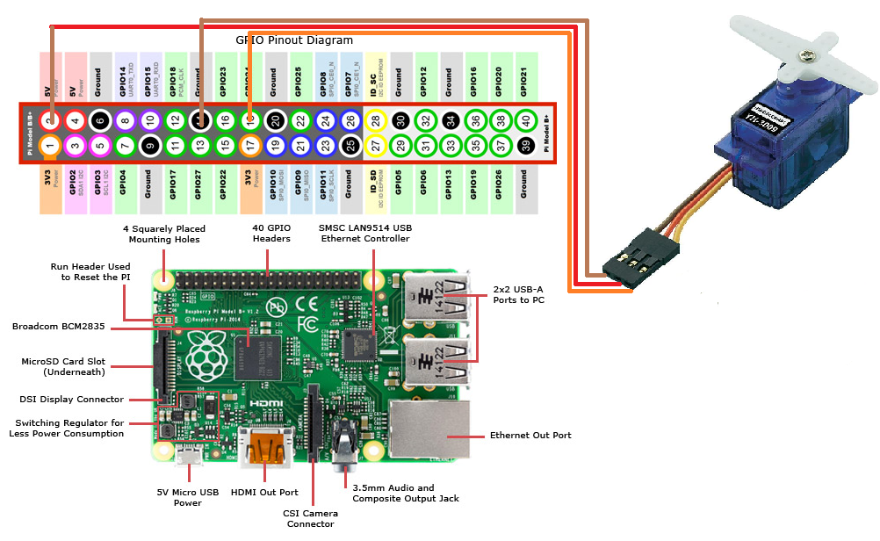
Servo RPI connection

Slide 3
Wiring Pi
Install
sudo apt-get install -y wiringpi
Test using commands
gpio -g mode 18 pwm
gpio pwm-ms
gpio pwmc 192
gpio pwmr 2000
gpio -g pwm 18 150
gpio -g pwm 18 200

Slide 4
Servo
if (wiringPiSetupGpio() == -1)
exit (1) ;
pinMode(18,PWM_OUTPUT);
pwmSetClock(192);
pwmSetRange (2000) ;
PwmWrite (18, 100); //servo 0 degree

Slide 5
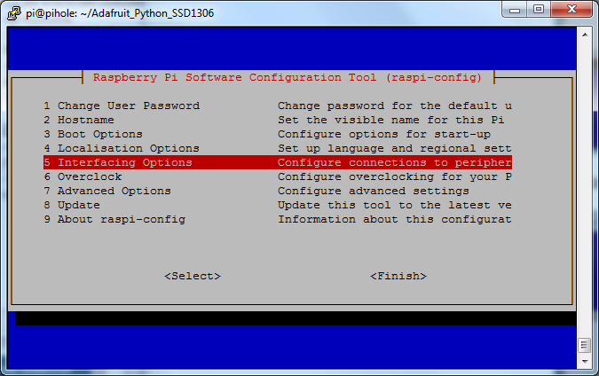
I2C Enable in RPI
sudo apt-get install -y i2c-tools
Run sudo raspi-config

Slide 6
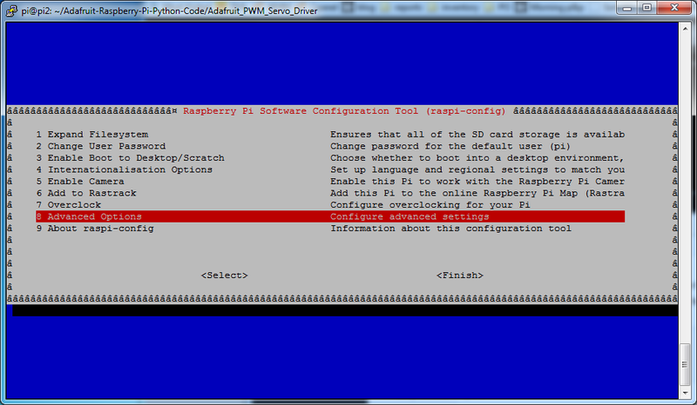
Second step

Slide 7
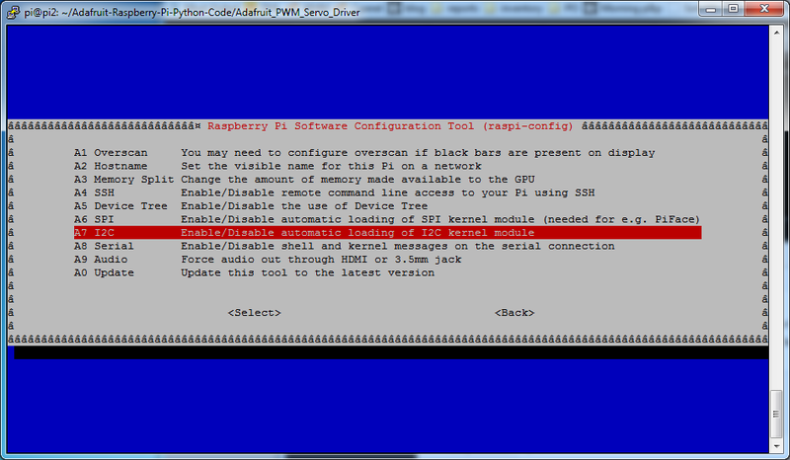
Third step

Slide 8
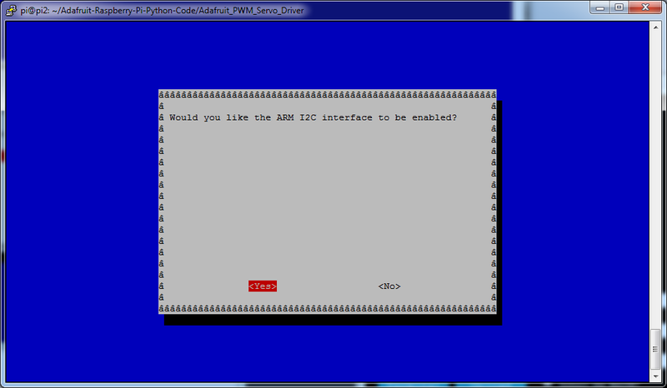
Fourth step : Enable

Slide 9
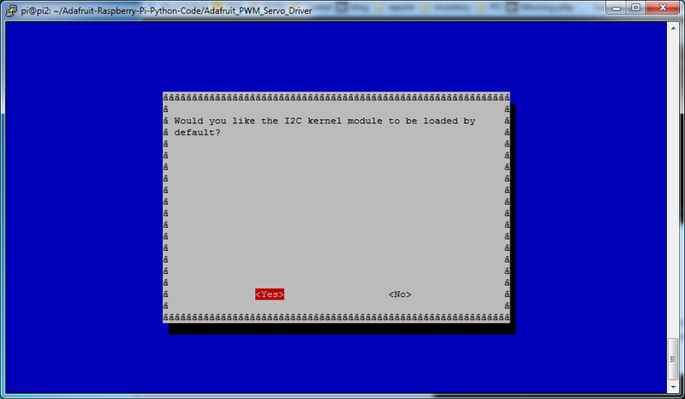
Fifth step : Kernel module loaded by default

Slide 10
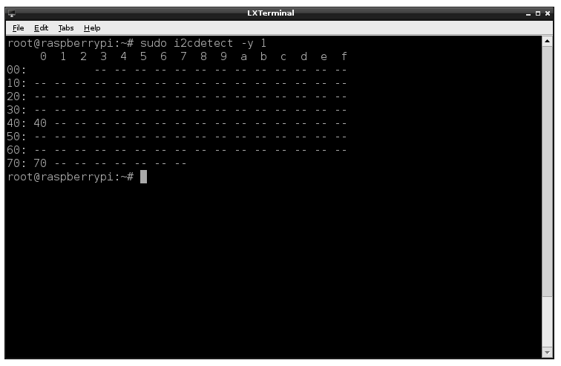
Sixth step : I2C Detect devices
sudo i2cdetect -y 1

Slide 11
I2C in Raspberry PI
WiringPiI2CwriteReg8
wiringPiI2CReadReg8

Slide 12
External Links
GPS NMEA
https://www.gpsinformation.org/dale/nmea.htm#GLL
DMS to Decimal
http://aprs.gids.nl/degMinSec.html
GPS ROS NODE
https://github.com/NovaRoverTeam/gps
MPU6050 ROS Node
https://github.com/matpalm/ros-mpu6050-node/blob/master/src/mpu6050_node.cpp
Tutorial of Goal to Point
https://www.youtube.com/watch?v=eJ4QPrYqMlw
Wiring Pi Examples
https://github.com/WiringPi/WiringPi/tree/master/examples
simulation Tutorial
https://wiki.nps.edu/pages/viewpage.action?pageId=818282511
Simulation
https://github.com/nickcharron/waypoint_nav

